Slide 1


CredX - mitigation of acquisition risk & assessing the Financial Risk
Group
Jyothi Thanam & APFE1680606
Siva Raghuram Susarla & DDA1610106
Avinash Kovvuri & DDA1610175
4. Shail Nadeem & DDA1610015

Slide 2
Business Understanding
Credx risk want to mitigate credit risk is to ‘acquire the right customers’
Identification of the right customers using predictive models. Using past data of the bank’s applicants
Determining the factors affecting credit risk
2 data sets in this project — demographic and credit bureau data
Demographic/ application data : . It contains customer-level information on age, gender, income, marital status, etc.
Credit bureau: Contains variables such as 'number of times 30 DPD or worse in last 3/6/12 months', 'outstanding balance', 'number of trades', etc
performance tag: Represents whether the applicant has gone 90 days past due or worse in the past 12-months (i.e. defaulted) after getting a credit card
In some cases, we find the variables in the credit bureau data are zero and credit card utilisation is missing. This represents no-hit in the credit bureau

Slide 3
Data cleaning and preparation
Creating a master file with all the relevant variables and conducting the necessary data quality checks and cleaning
For credit risk analytics, the weight of evidence (WOE) (and, equivalently, information value analysis) are used to identify the important variables.
Replace the actual values of all the variables by the corresponding WOE value and store the data in a separate file (e.g. woe_data) for further analysis
Demographic data model: Building a model to predict the likelihood of default using only the demographic data. This will give you a good idea of the predictive power of the application data. Obviously, the final model will use the credit bureau data as well, though this model is an important part of understanding the predictive power of application data.
Model using both demographic and credit bureau data: Building a model to predict default using both the data sets.

Slide 4
Model evaluation
Evaluating the models using relevant metrics and reporting the results. As a part of model validation, predict the likelihood of default for the rejected candidates and assess whether the results correspond to your expectations.
Application scorecard
Building an application scorecard with the good to bad odds of 10 to 1 at a score of 400 doubling every 20 points
calculating the application scores and assess the results. Compare the scores of the rejected population with the approved candidates and comment on the observations
basis of the scorecard, identify the cut-off score below which you would not grant credit cards to applicants

Slide 5
Assessing the financial benefit of your project
The potential financial benefit of your project to the management of the bank. From a P&L perspective, identify the metrics you are trying to optimise, explain (in simple terms) how the analysis and the model works, and share the results of the model.

Slide 6
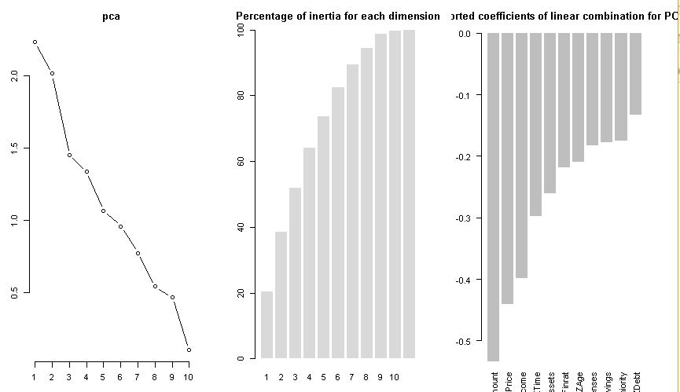
PCA Linear Combination of Varibales

Slide 7
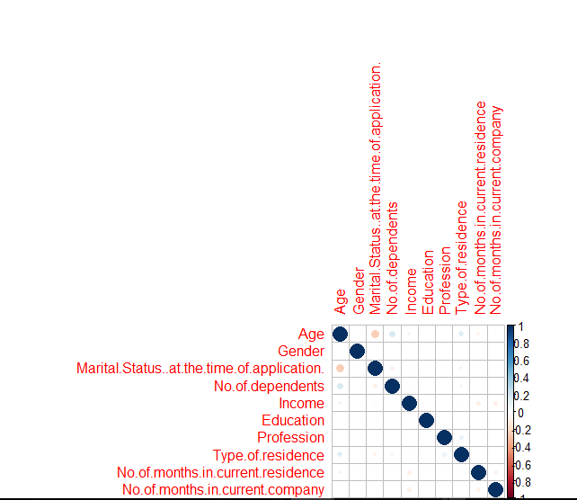
Correlation of Variables

Slide 8
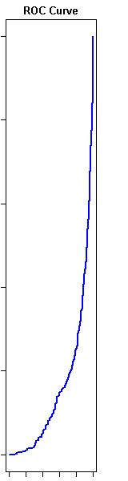
ROC of Logistic Regression

Slide 9
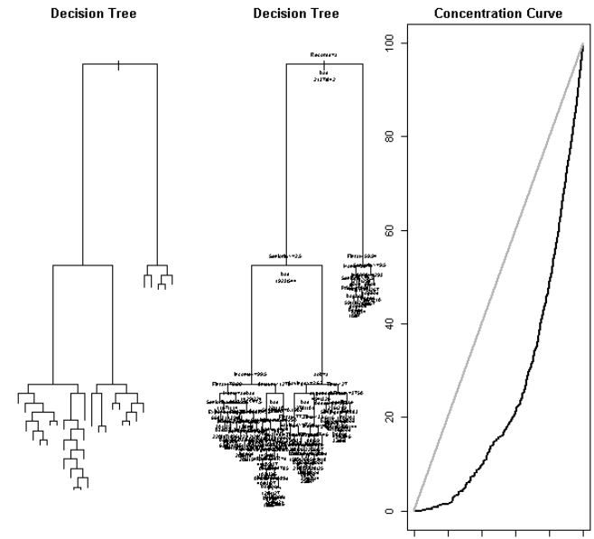
Decision Tree

Slide 10
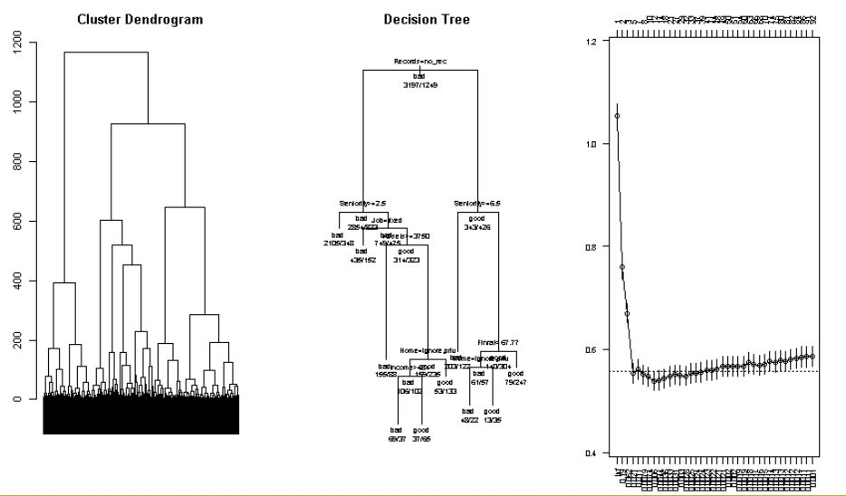
Clustering – KNN dendogram

Slide 11
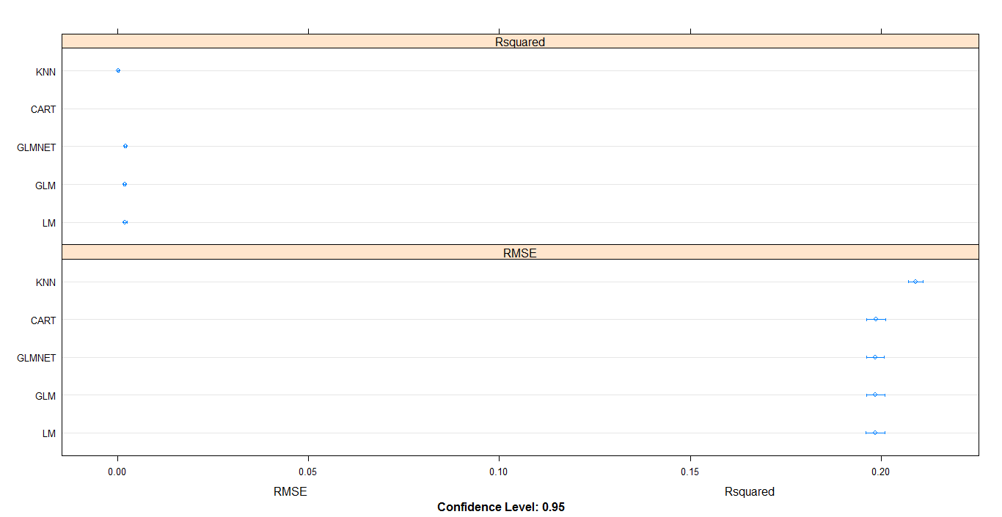
Final ML Algorithm's Performance

Slide 12
Application scorecard & Financial benefit
The Random Forest ML model Gives has low RMSE and can better predict the values with high precision and accuracy
means that when selecting 20% of the records based on the model,
one can expect 3.4 times the total number of targets (events) found by randomly
selecting 20%-of-records without a model. In terms of Credit default model ,
we can say we can cover 4 times the number of attritors by selecting only 20% of the
customers based on the model as compared to 20% customer selection randomly.
representation of the advantage of using a predictive model to choose which
For example, by giving credit cards to only 10% of customers based on the predictive model we will reach 3 times less defaulters as if we use no model.

Slide 13


